Slide 1
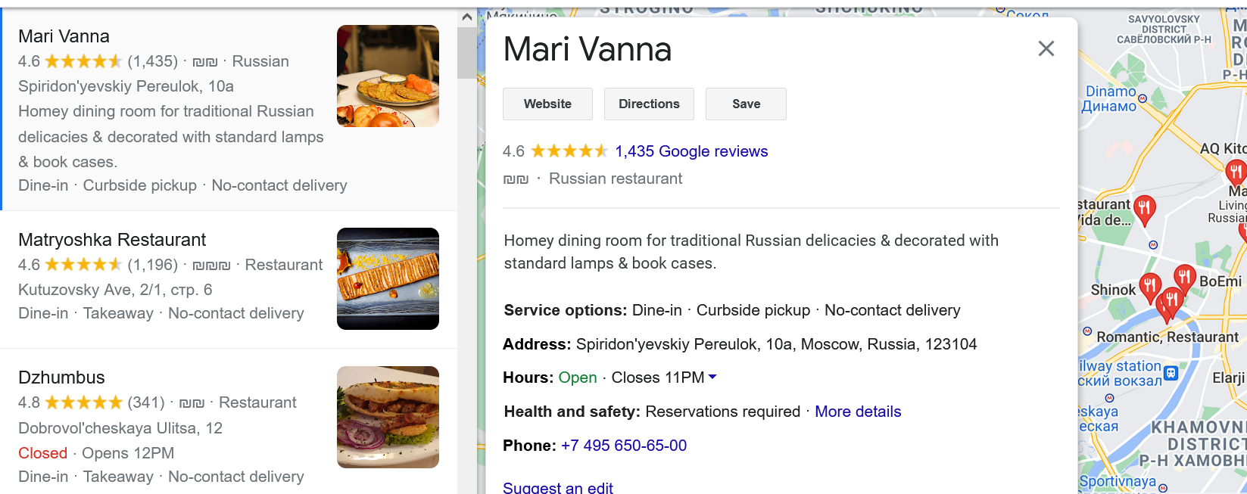
1
4
2
7
6
3
5
8
9
10
https://www.google.com/search?q=moscow%20restaurants&sxsrf=AOaemvLJmfwXLbJLevivC_gtj8OYYJjslA:1633936727568&source=hp&ei=TeVjYYvyBOeFjLsPm5mJ4AM&iflsig=ALs-wAMAAAAAYWPzXRAt5E7U9Ytm6e4KhTENC5Vn9BhP&ved=2ahUKEwi-nO3R6MHzAhXMsKQKHfvjDbwQvS56BAgDEFQ&uact=5&oq=moscow+restaurants&gs_lcp=Cgdnd3Mtd2l6EANQTFioCmCKDGgAcAB4AIABAIgBAJIBAJgBAKABAQ&sclient=gws-wiz&tbs=lf:1,lf_ui:9&tbm=lcl&rflfq=1&num=10&rldimm=12805638519326463957&lqi=ChJtb3Njb3cgcmVzdGF1cmFudHNIkqST1eaAgIAIWhwQARgBIhJtb3Njb3cgcmVzdGF1cmFudHMqAggDkgEScnVzc2lhbl9yZXN0YXVyYW50qgEMEAEqCCIEZm9vZCgA&phdesc=ECnuRhGpwQE&rlst=f#rlfi=hd:;si:12805638519326463957,l,ChJtb3Njb3cgcmVzdGF1cmFudHNIkqST1eaAgIAIWhwQARgBIhJtb3Njb3cgcmVzdGF1cmFudHMqAggDkgEScnVzc2lhbl9yZXN0YXVyYW50qgEMEAEqCCIEZm9vZCgA,y,ECnuRhGpwQE;mv:[[55.7766137,37.6744487],[55.7297468,37.5522]]

Slide 2
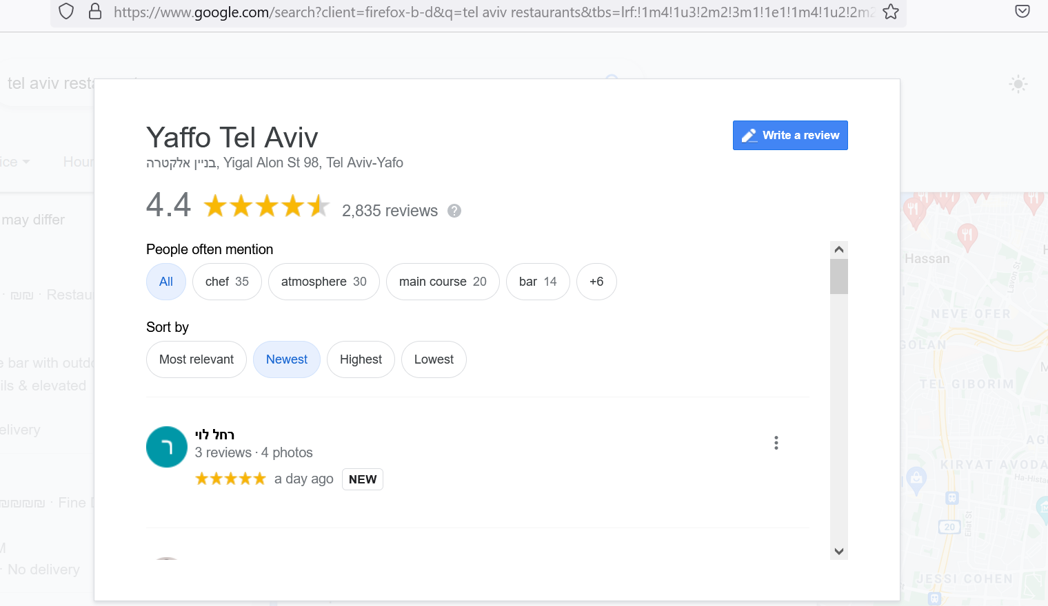
11
12

Slide 3
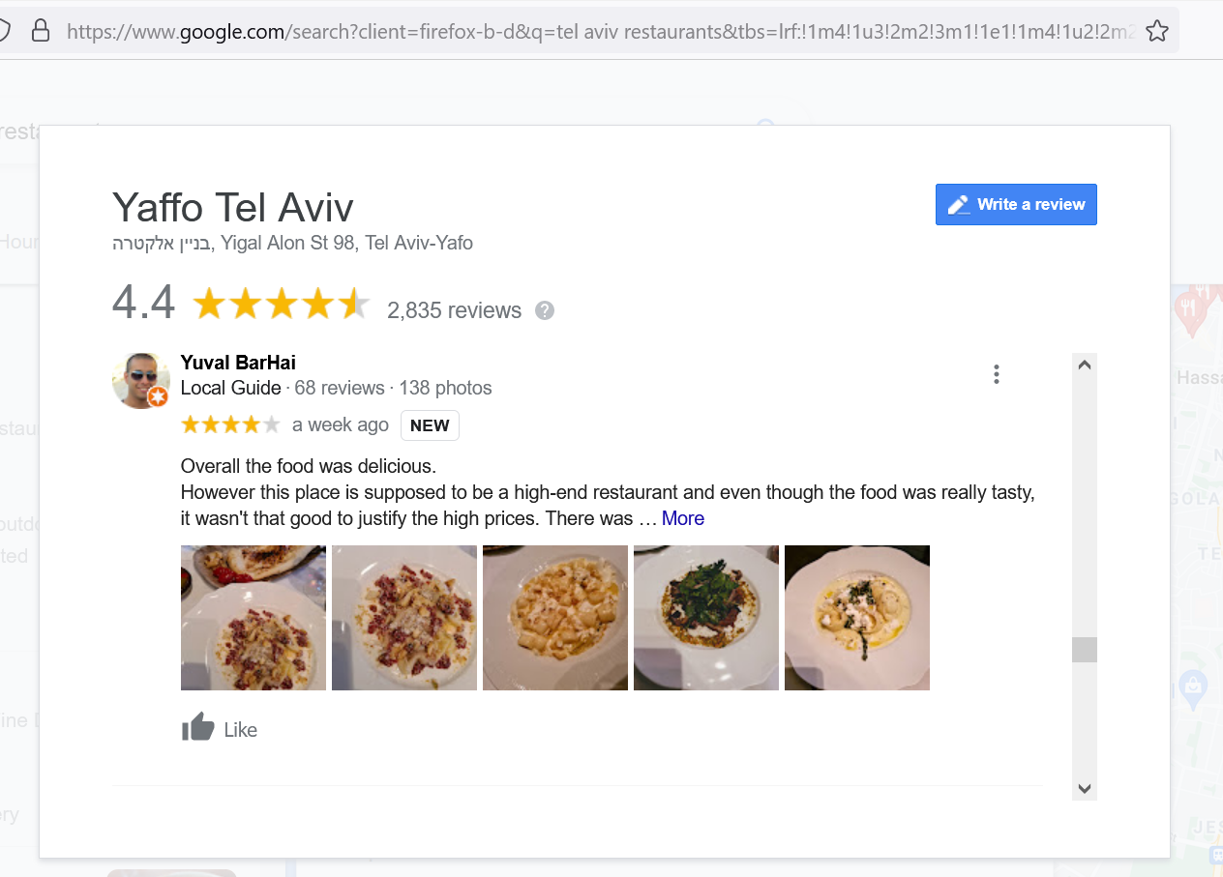
13
14
16
15
17
20
19

Slide 4
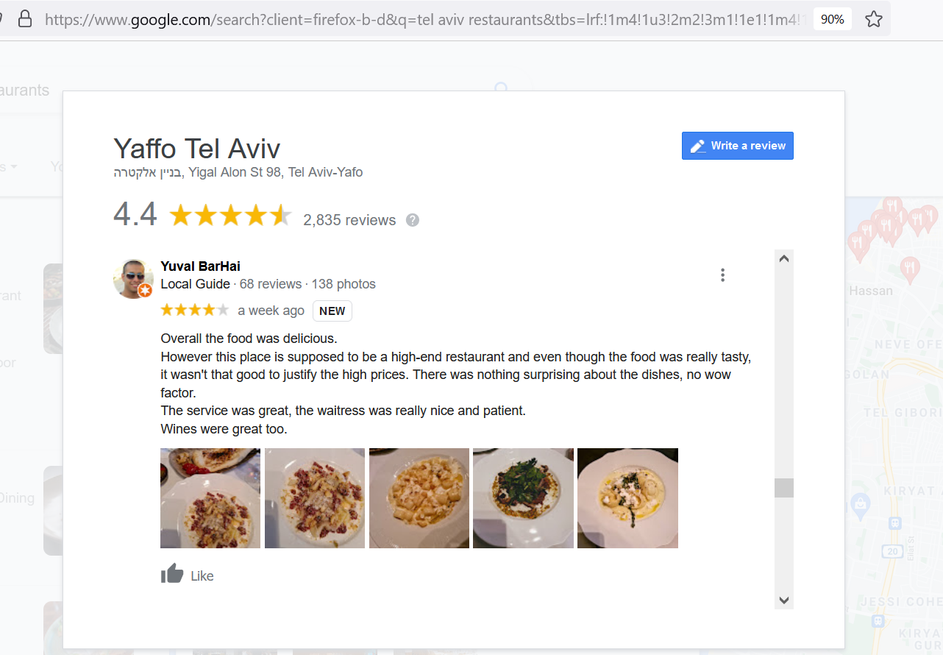
17

Slide 5
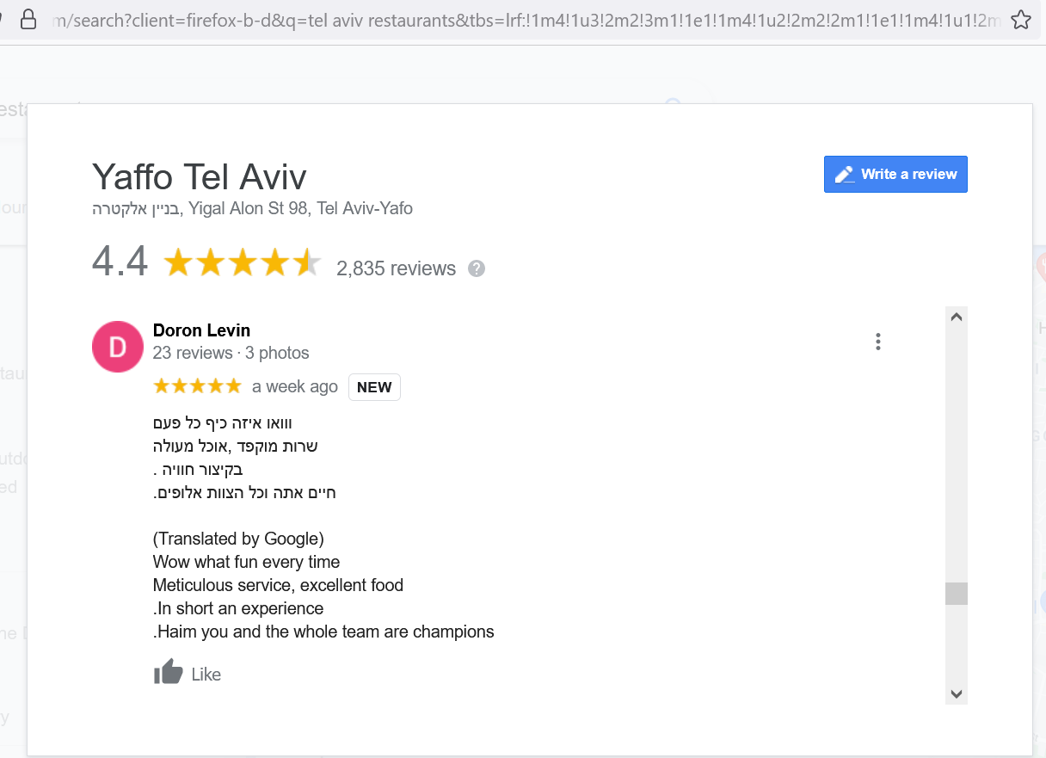
18

Slide 6
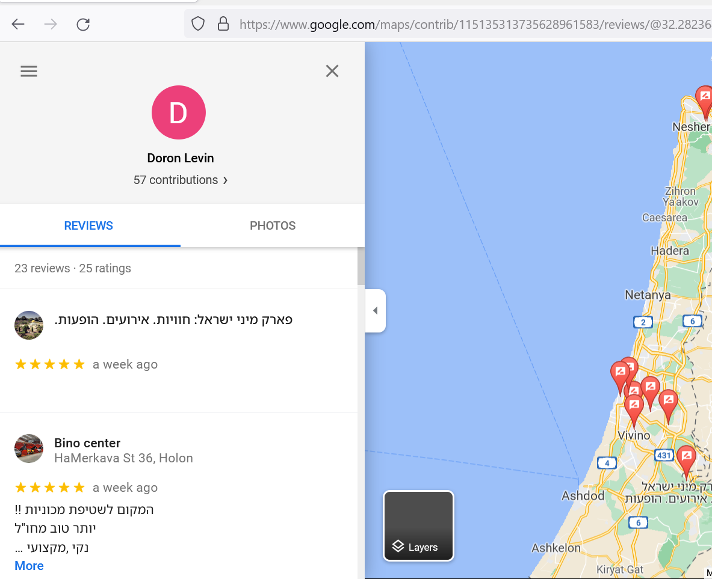
21

Slide 7
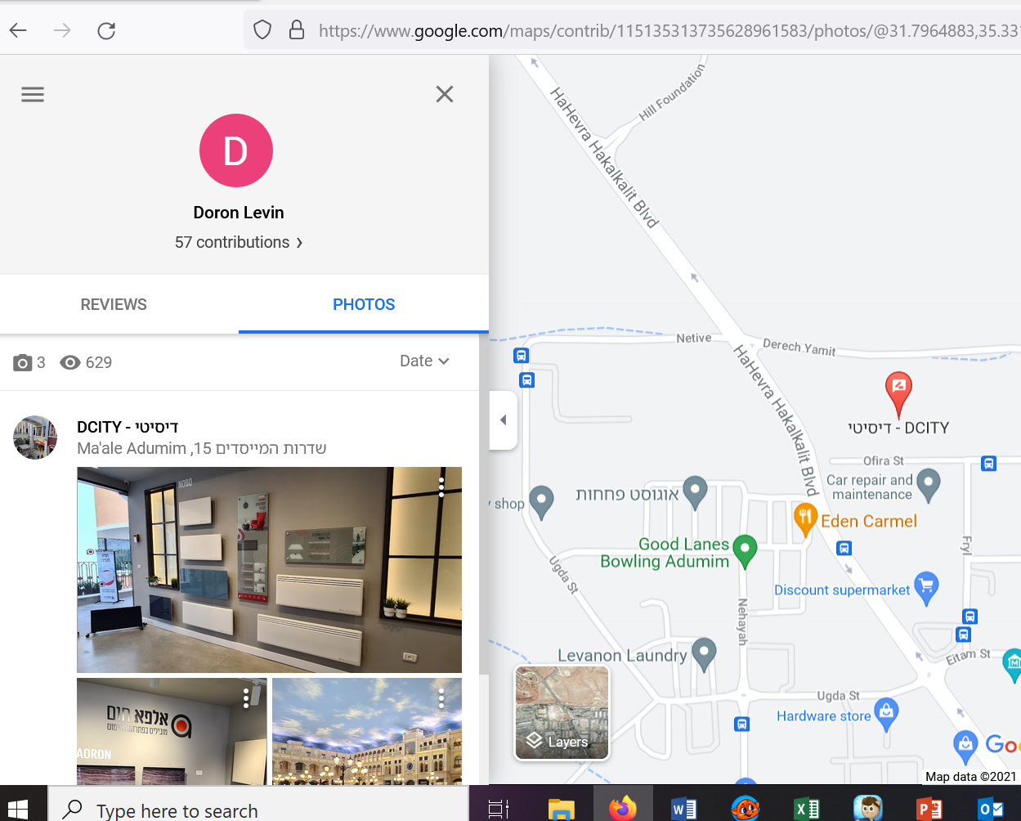
22

Slide 8
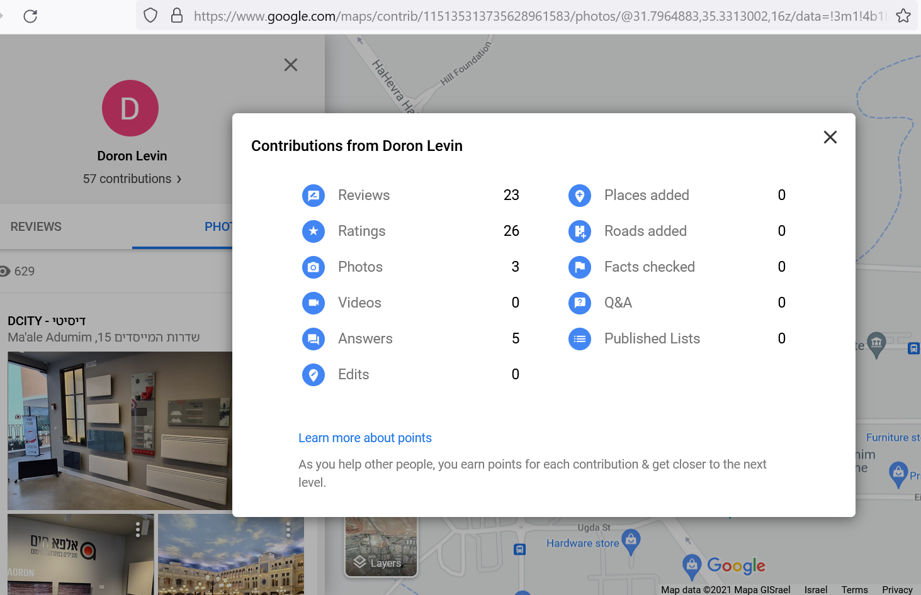
23
29
30
24
31
25
26
32
27
33
28

Slide 9
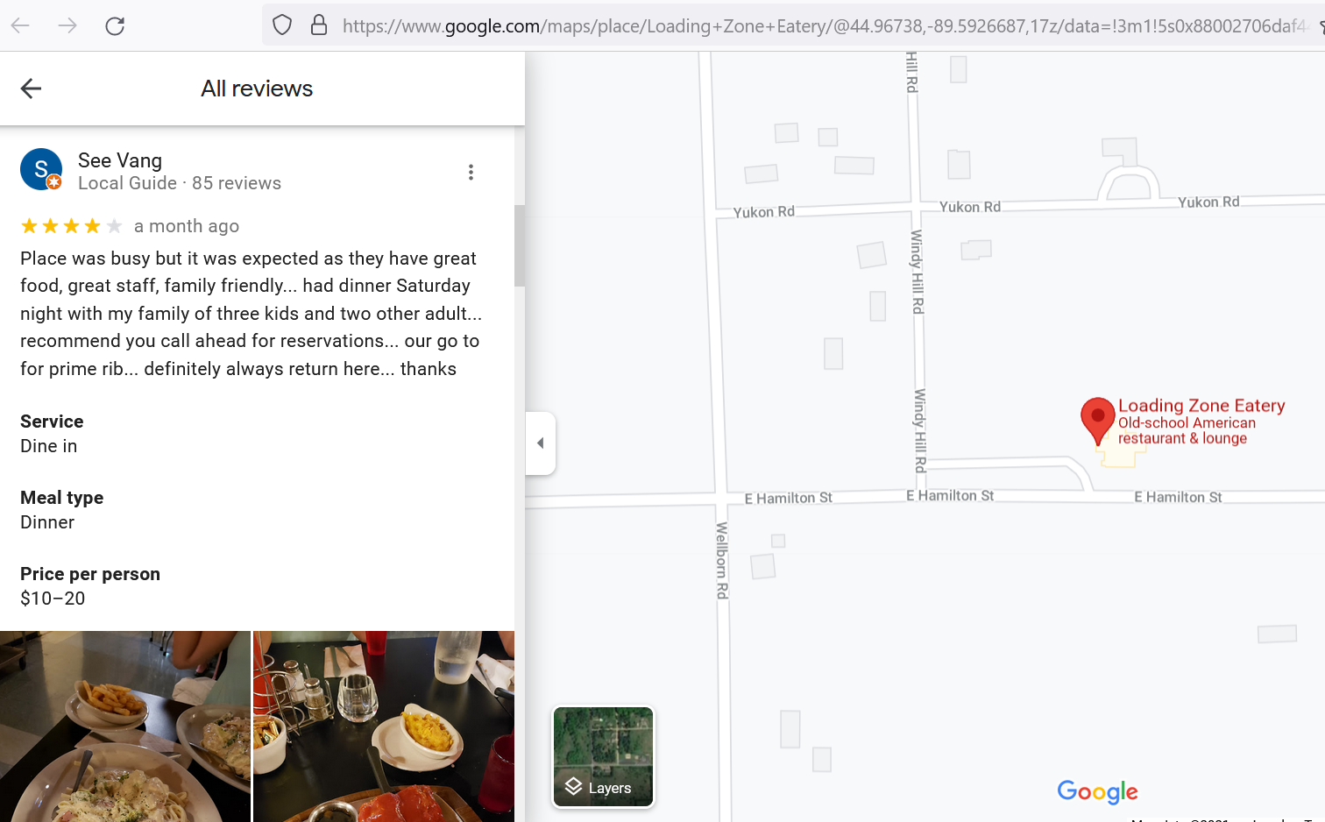
34
35
36
https://www.google.com/maps/place/Loading+Zone+Eatery/@44.96738,-89.5926687,17z/data=!3m1!5s0x88002706daf44369:0x175720066c8566f1!4m15!1m7!3m6!1s0x88002706c4db44d1:0xc7c08369b724db67!2s157024+E+Hamilton+St,+Wausau,+WI+54403,+USA!3b1!8m2!3d44.96738!4d-89.59048!3m6!1s0x88002706c4c34691:0xd929c8559f2f044d!8m2!3d44.96738!4d-89.59048!9m1!1b1

Slide 10
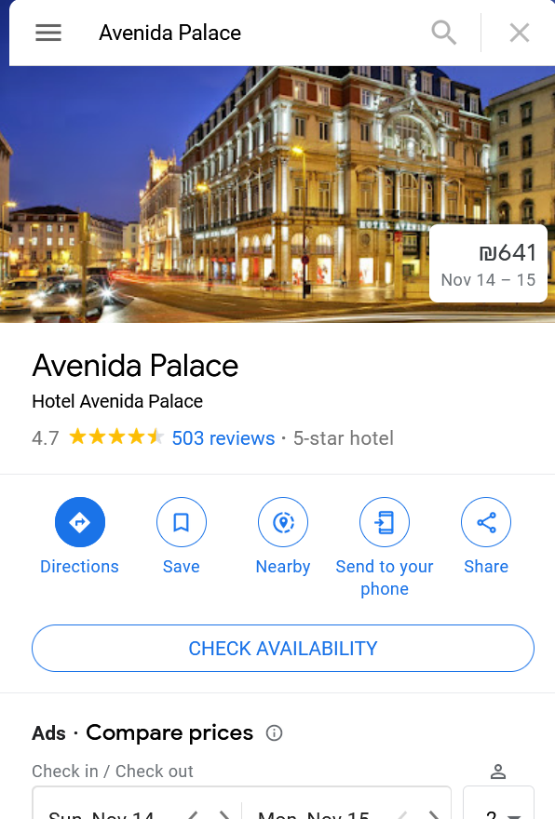
38
37
39
41
40
https://www.google.com/maps/place/Avenida+Palace/@38.7225728,-9.1412372,15z/data=!4m8!3m7!1s0x0:0x1dc7c0f9db2726ef!5m2!4m1!1i2!8m2!3d38.714855!4d-9.141134

Slide 11
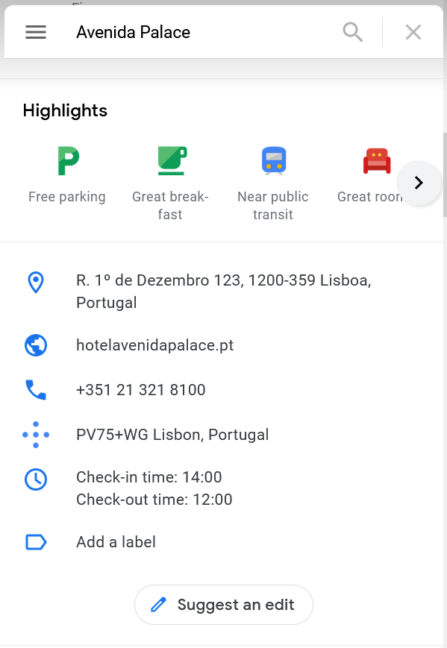
42
44
43
45

Slide 12
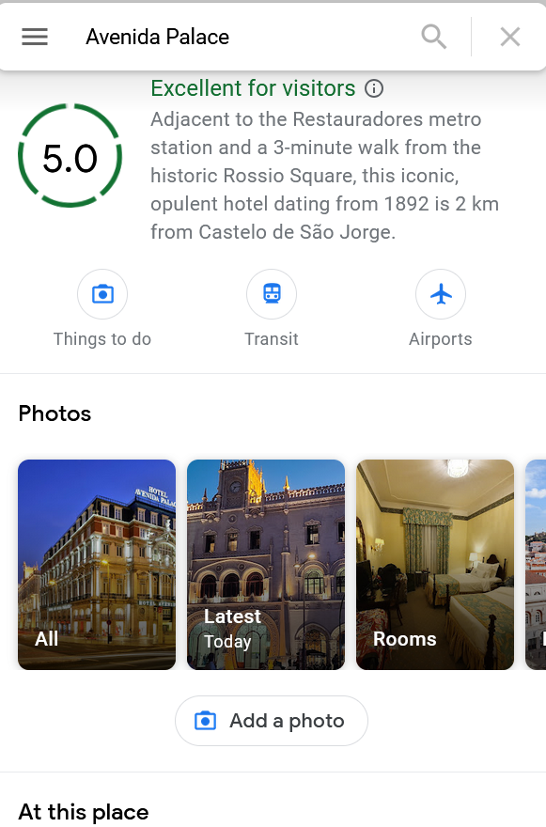
46
47

Slide 13
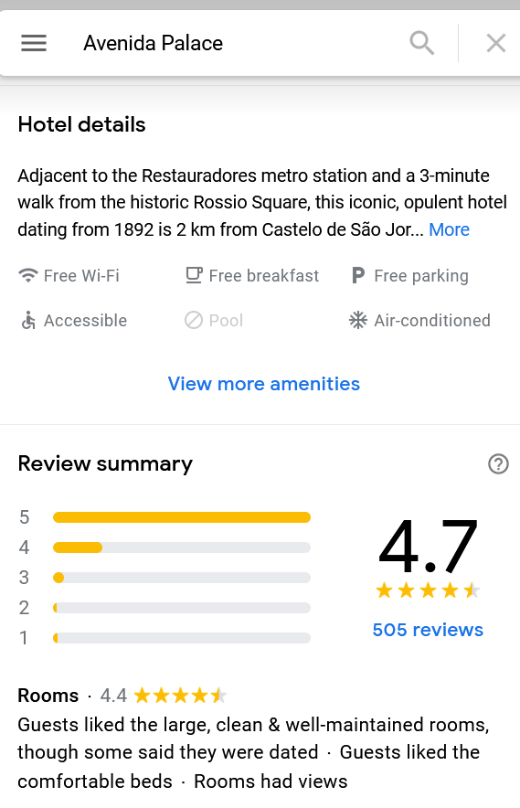
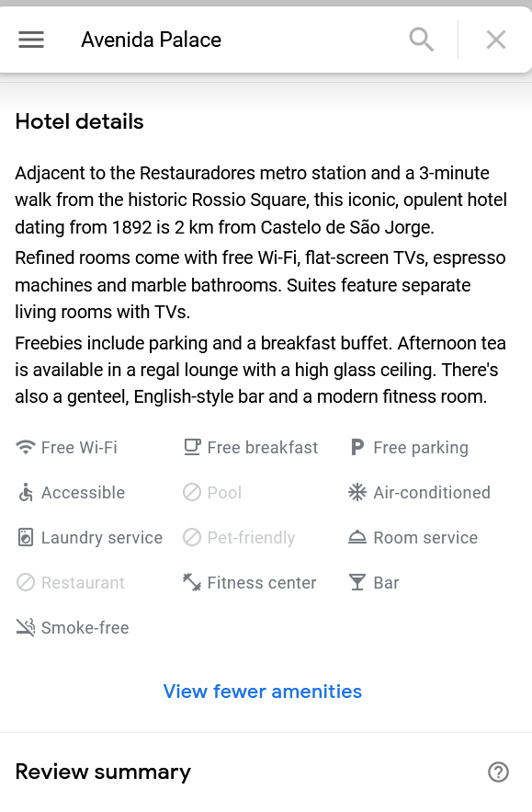
48
49
50

Slide 14
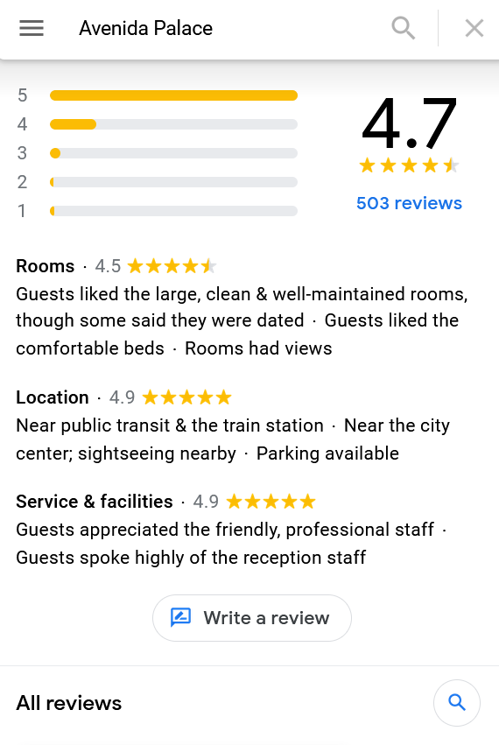
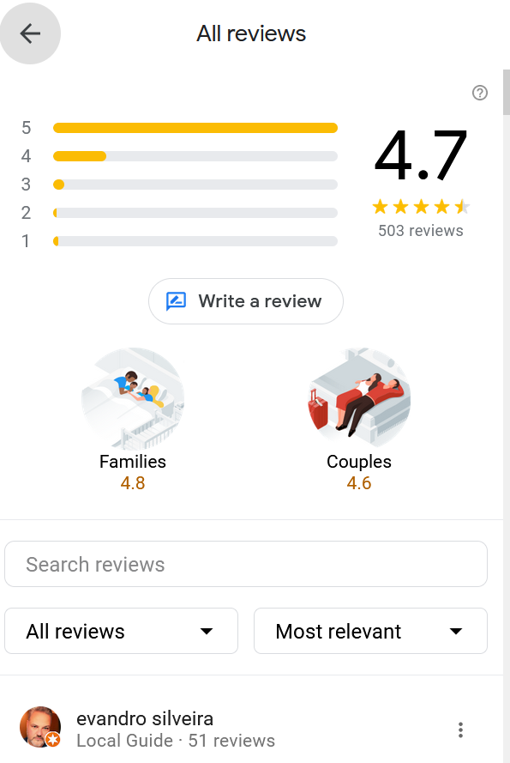
51

Slide 15
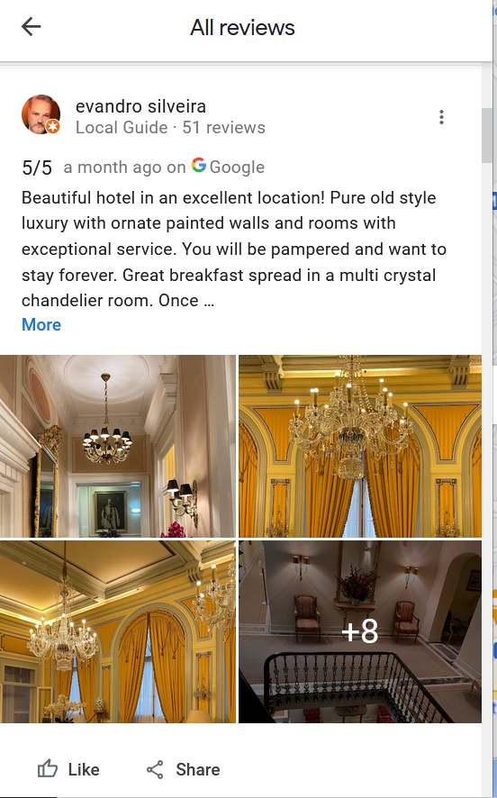
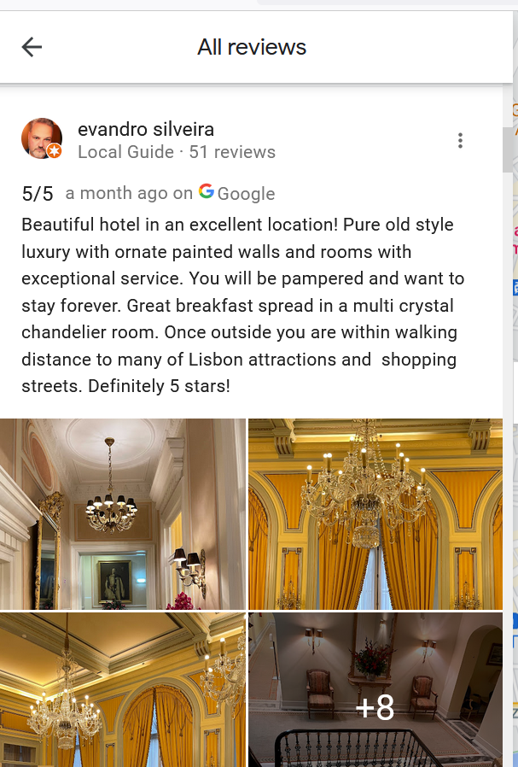
55
56
53
54
57
52
58
59
60

Slide 16
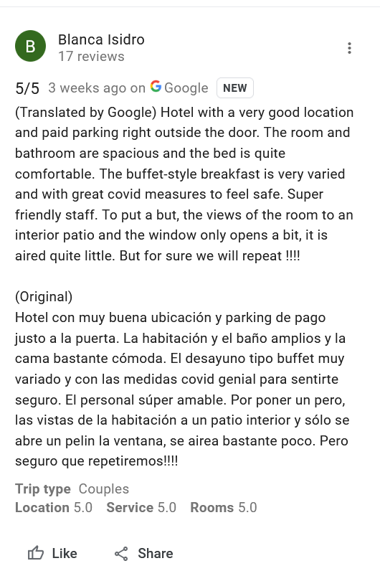
61
https://www.google.com/maps/place/Eurostars+Blue+Coru%C3%B1a/@43.3665839,-8.4104223,17z/data=!4m22!1m11!3m10!1s0xd2e7c62e62a34f3:0xc58783e46a6d097!2sHotel+Riazor!5m2!4m1!1i2!8m2!3d43.3683583!4d-8.4091348!9m1!1b1!3m9!1s0xd2e7c87857ef09d:0x9d85535b8d0eb663!5m2!4m1!1i2!8m2!3d43.3664343!4d-8.4054035!9m1!1b1

Slide 17
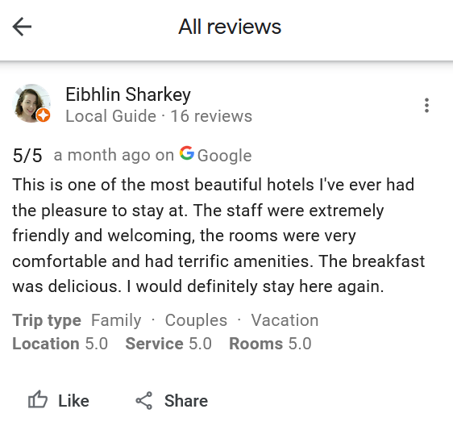
62
63
64
65

